Slide 1
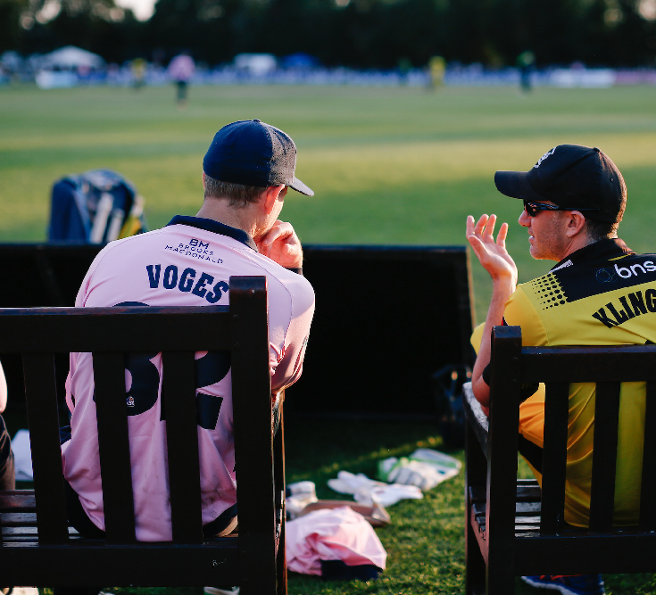
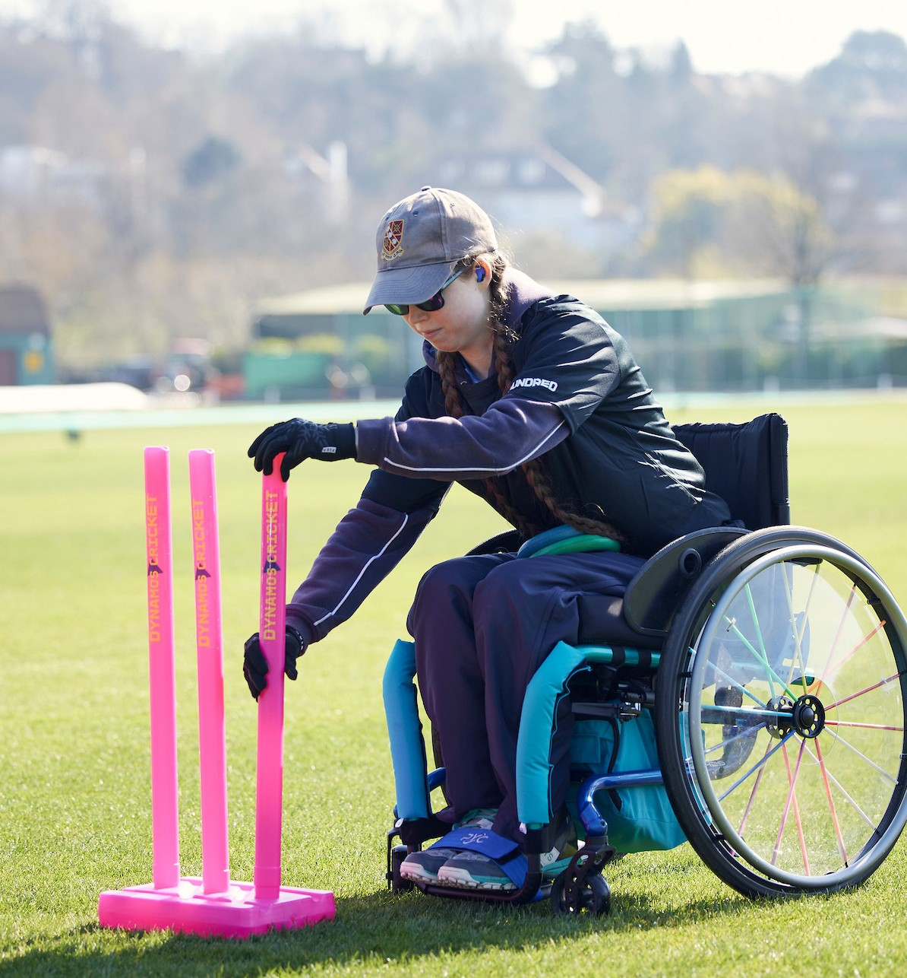

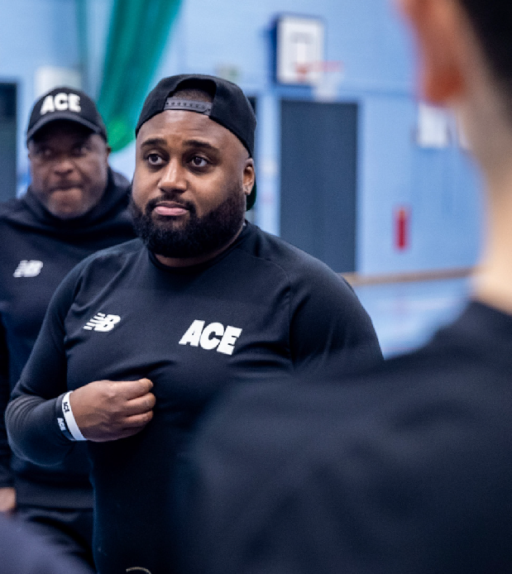
INTRODUCTION

Slide 2

CONTENTS
3 - 8 The need for a Statement of Intent (SOI)
9 - 10 How it was developed and where it will sit
11 - 14 Raising The Game manifesto, rationale and design 15 - 18 How Raising The Game will be used
19 - 22 Action not just words
23 Judging success
24 - 25 How to request brand guidelines and assets

Slide 3
INTRODUCTION TO ‘RAISING THE GAME’
All of us who work in or play cricket accept that more can be done to ensure it is a game for everyone. Like many sports, sectors and industries, the unfortunate reality of cricket in the 21st century is that it is not as inclusive as it should be.
Thankfully, there is a huge amount of inspirational and life-changing work going on across the game to change this. From Lancashire CCC’s gender-inclusive tour to Dubai, to the ACE Programme’s work to encourage young people of African and Caribbean heritage into cricket, and the opportunities for disabled children to play cricket offered through The Lord’s Taverners Super 1s programme, there is much that we can be proud of.
That’s why we have worked with over 40 stakeholders across the network to create Raising The Game: a new national rallying cry based on a manifesto for change. The platform gives greater visibility to work that is driving change forwards, amplifying unheard voices and ensuring everyone feels a sense of belonging. It’s a vehicle for all of us to move forward with the same goal: that everyone who wants to play, watch, or work in cricket is welcome and included.

Slide 4
INTRODUCTION TO ‘RAISING THE GAME’
We want you to take shared ownership of Raising The Game. The ECB may have created it, but we do not own it. We want First Class Counties, County Cricket Boards, recreational clubs and delivery partners to use the platform to showcase initiatives, inspire new projects, and reach out to underrepresented communities. By doing so, we hope you can work with us to eradicate discrimination, make cricket more inclusive, create more equitable opportunities, and deliver on our collective equity, diversity and inclusion (EDI) ambitions.
Kate Miller, Chief Diversity and Communications Officer, ECB

Slide 5
THE NEED FOR RAISING THE GAME
RACISM IN CRICKET
OVER A THIRD
of Black and ethnic minority cricketers have experienced racism in the county game (source: PCA)
WOMEN WORKING IN SPORT
LGBTQ+
43% OF LGBTQ+
people think public sporting events aren’t a welcoming space for them (Stonewall/YouGov)
40%
of women working in sport feel they are valued less than men in the workplace because of their gender (ECB)
BLACK PROFESSIONAL CRICKETERS
DOWN 75%
The number of Black professional cricketers has fallen 75% in the past 25 years (ACE)
DISABLED PEOPLE
Fewer than half of disabled people
47%
GIRLS’ SECTIONS
ONLY 15%
of clubs have a women’s and/or girls’ section (ECB)
think physical activity and exercise is for ‘someone like me’, a significant decline from 57% in 2020 (Activity Alliance)

Slide 6

THE NEED FOR RAISING THE GAME
The difficulties of the past year have left people in the game feeling disconnected and divided
Following a difficult year, we need to find a way for the game to be more visible in its EDI work
How can we make everyone feel like they belong and are moving in the same direction again?
How can we demonstrate the variety of great work that is going on?

Slide 7
THE SOLUTION
An equity, diversity and inclusion (EDI) ‘Statement of Intent’ (SOI) to demonstrate our long-term commitment to action across the game – it’s not a quickfire marcomms campaign
To demonstrate all the EDI work that has been and is already happening across the game – illustrating breadth and depth
To reunite and unify the game under a common purpose after challenging times – we are all moving forwards in the same direction, together
To provide more opportunities to highlight best practice across the game, generate visibility and encourage more positive action
To act as a reminder to the game that we all have a responsibility to make cricket more equitable, inclusive and diverse – an EDI culture

Slide 8

Raising The Game will illuminate the progress made through the EDI Action Plan and the Gamewide Commitments
EMPOWER PEOPLE
We will:
Deliver game wide EDI education
Encourage and support personal development and learning across the game
Bring people across the game together through game wide communities
BUILD DIVERSE TEAMS
We will:
Strengthen our approach to fair recruitment and work with our partners to help them achieve the same
Establish transparent development, progression and promotion processes and work with our partners to help them achieve the same
DEVELOP INCLUSIVE ENVIRONMENTS
We will:
Conduct a full review of our HR policies and work with our partners to help them deliver the same
Drive out discrimination across the game
Work with the game to create a welcoming culture that is
consciously inclusive at all levels
LEAD WITH ACCOUNTABILITY
We will:
Ensure the Independent Commission for Equity in Cricket reports publicly and transparently
Set the standard and ensure the whole game appreciates the importance of
implementing a culture that is diverse and inclusive

Slide 9

RAISING THE GAME
HOW WE DEVELOPED IT
15+ interviews
4 workshops Testing with
40+ diverse and representative stakeholders
ETHOS
The Raising The Game Statement of Intent was designed to reflect the wishes of stakeholders across the game. They asked that it’s:
Honest and humble
Future looking
Proactive and positive
Reflecting the whole game
Based on real examples and experiences
It was also designed to help:
Increase a sense of belonging
Share and show best practice and showcase heroes and role models

Slide 10
WHERE IT SITS
RAISING THE GAME
Arena | ECB | Professional cricket | Recreational cricket |  | Partners
Actions | Gamewide Commitments | EDI educational content | Club commitment to EDI |  | Specialist programmes
 | EDI educational content | Players and officials training | Volunteers, coaches and player education |  | Case studies
 | Campaign Communities | Spokespeople and support | Amplification and case studies |  | Loaned channels
 |  | Supporters’ groups | Welcoming environment, club caters to all | Events and sponsorship

Slide 11
MANIFESTO
We are all part of this game because of its power to connect communities and change lives.
We know that the strength of a team in cricket – both on and off the pitch – comes from the difference and individuality within it.
So, let’s all move forwards with the same goal: that everyone who wants to play, watch or work in cricket feels welcome and included.
Let’s call it out, loud and clear: there is no room for hate, discrimination or intolerance in this game.
Let’s commit to positive action by everyone, every day – educating ourselves and each other; being considerate of different needs and perspectives; knowing we can always do better.
Raising understanding, raising opportunities, raising the bar and raising a smile.
Whether playing, delivering or supporting cricket, together we all have a role to play in Raising The Game.

Slide 12
THE WHY
Means continuous, collective improvement, because there is always work to do in this space.
There will always be ways to improve and better serve our people, players, fans, volunteers, supporters and the wider public as a game, as society evolves.
It is also a word that suggests action and accountability on EDI – crucial in making more people feel ‘cricket is a game for me’.
Means the ECB, network and stakeholders (and, in time, extending to fans, viewers, recreational players etc) who can all play a positive role in our EDI efforts and helping more people feel ‘cricket is a game for me’.
Raising The Game can be used singularly about the ECB or a county or a player or official or individual, as well as about our shared, gamewide efforts.
It can speak to the current cricket family and show those who have been made to feel cricket is not for them that the game is changing.

Slide 13

RAISING THE GAME
CHECKLIST
When you are thinking of using Raising The Game, please ask these questions:
Is this a specific EDI initiative?
Does this initiative show how you are understanding and meeting a representative range of experiences, perceptions and needs?
Does this initiative stand against hate, discrimination or intolerance?
Is this initiative genuinely about helping everyone thrive (whether playing, delivering or supporting cricket), no matter who they are?

Slide 14
COLOURWAYS

Slide 15

HOW WILL IT BE USED?
CHANNELS
A variety of branded platforms / channels showcasing stories from across the game
BADGE
A ‘kitemark’ on materials from the ECB, counties and partners / lock–ups see example below
OWNERSHIP
To sit over specific initiatives such as the upcoming EDI Content Hub
CULTURE
To help people think about internal action and culture, as well as external initiatives

Slide 16
MESSAGING
RAISING
UNDERSTANDING
Raising The Game means increasing our understanding of why EDI matters and our understanding of other peoples’ experiences, perceptions and needs
RAISING
THE BAR
Raising The Game means making it clear there is no room in our sport for hate, discrimination or intolerance. It means
setting higher standards and targets – and holding ourselves to account in making the game more inclusive and accessible
RAISING
OPPORTUNITIES
Raising The Game means ensuring more people have
opportunities to fulfil their potential in our game and that those opportunities give
a fair playing field, whoever you are
RAISING
A SMILE
Raising The Game means more than just including everyone. It means helping them thrive, so anyone who wants to play, watch or work in the game can enjoy the experience

Slide 17
STORYTELLING
In line with our comms approach to people-first storytelling, where possible, when illustrating Raising The Game, we want to do it through a human lens, making it more compelling for people to understand. The messaging will be woven into all EDI copy, scripts, Q&As, encouraging consistency and adoption across the network.
If we were talking about the Iftar at Lord’s, we’d lead with the story of it being Tameena Hussain’s idea
If we were talking about Dream Big Desi Women, we’d do it through the story of one of our Activators
If we were talking about supporting more women into umpiring roles, we’d do it through Sue Redfern’s journey
If we were talking about the importance of diverse teams, we might do it through the story of the men’s ODI team
If you were talking about top cricketers supporting young disabled players, you might do it through the words of Southern Brave’s Maia Bouchier visiting a Super 1s session and the young people she met
Etc...

Slide 18
INTEGRATION
We want to encourage our stakeholders – from ECB teams, to county, commercial and delivery partners – to adopt the Raising The Game logo and messaging, using it alongside their own on their work / project, signifying it is all part of the same EDI effort. However, please do not use Raising The Game too generally. It should be linked to work that has EDI as its main driver as opposed to overall organisations / brands.
PLEASE DO USE
On any positive EDI efforts:
Internal communication
External campaigns
Social media posts
Web copy / pages
Briefing for spokespeople and players
In-ground announcements
In-ground signage (posters, programmes)
In-ground branding (big screen, LEDs)
PLEASE DON’T USE
On every communication you put out – whilst EDI is intrinsic to every part of the game, don’t feel you need to put Raising The Game on everything or it could devalue the intention and outcome.
To use Raising The Game, please request the brand guide and assets via the Raising The Game page of the ECB website

Slide 19
RAISING THE GAME MUST BE ABOUT ACTION NOT JUST WORDS
It’s clear that EDI efforts must have accountable action and that there must be consequences when things happen that are not acceptable, such as hate or discrimination. The Gamewide Action Plan is clear on steps being taken to improve the game – and it has clear metrics and regular reporting milestones. This is an important step in continued gamewide progress.
Raising The Game spans these initiatives but is also about individual action. How it comes to life for you will depend on your organisation, where you are at on your EDI journey, your personal job role and more. You might have been one of the driving forces behind Raising The Game for decades and so this is second nature. You might be just starting out understanding the importance of EDI and how to put it into practice. Or you might be somewhere in between.
Think about Raising The Game as not just something to say you will do but as what positive action you can take to do so, as an organisation and as a person. EDI is not just about stopping obvious discrimination and racism, it’s also about the positive action we can all take to improve the game for everyone.
We’d love to hear your examples, please share your stories and suggestions here.

Slide 20
WHAT THE ECB IS DOING
Raising The Game webpage showcasing EDI stories from across the game.
ECB blog with a consistent EDI lens and diversity KPIs.
Monthly EDI campaigns focus aligned to calendar – capturing case studies for earned
and owned channels.
New EDI podcast for the game – hot off
the press!
COMING SOON
Raising The Game
e-newsletter for the game.
Loaned channel amplification of EDI work through media and influencer partners.

Slide 21
WHAT CAN YOU DO?
Some examples...
Adding a prompt to meeting agendas asking if people have accessibility needs (not just asking for dietary
requirements).
Adding ALT-TEXT whenever you post pictures on social media, subtitling videos, using plain language, offering large print formats of materials.
Adding useful information to your email signature (for example pronouns).
Ensuring there are alternatives to alcohol at social events.
Be curious and look for ways to understand others’ experiences. For example by following a wider range of people on social media
– or starting a ‘representative reading list’ for you and your colleagues to add to.
Being an ally and active bystander. We can all be role models in the EDI space if we lead by example.

Slide 22
EMBEDDING RAISING THE GAME IN EVERYDAY PROCESSES
STOP
Before you do something, STOP…
LOOK
At what you’re doing. Does it reflect society, the audience you are trying to reach? Is it accessible?
LISTEN
To the people you’re trying to engage.
Have their views been taken into account?
THINK
About people different from you. What could help someone feel a better sense of belonging?
SUGGEST
If something is wrong or could be better, and you feel can do so, suggest what needs to change.
LEARN
About people with different life experience to you – social media can be
a great place to do this.
You may have your own process in place but if not, this is an example of one to follow to ensure EDI is embedded into every day processes (thinking, planning and delivery):

Slide 23
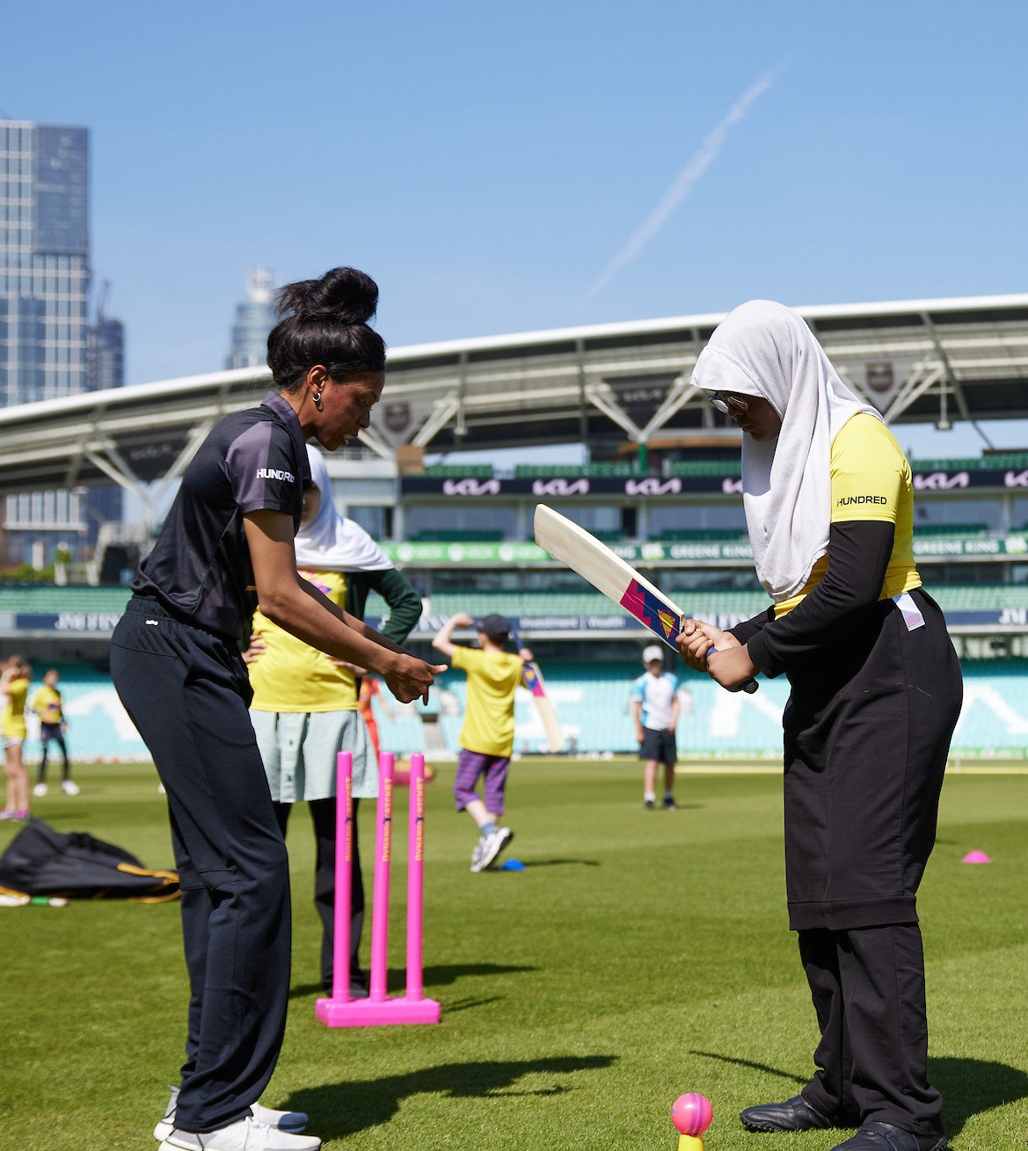
WHAT SUCCESS LOOKS LIKE
Widespread awareness across the network and partner portfolio of what Raising The Game intends to do
Positive sentiment from across the network about the intention of Raising The Game
Widespread adoption of the logo and messaging across relevant projects
Improved visibility of EDI work from across the network – increased volume of stories and
platforms covering Raising The Game updates
Raising The Game integration in to everyday culture

Slide 24
REMINDER: TO REQUEST RAISING THE GAME ASSETS
We hope that Raising The Game will be adopted across the game.
It will help show our serious, collective intent to make the game more welcoming, inclusive and diverse and act as a reminder to all of us that whatever our role, we have a part to play.
The Raising The Game assets will be available to download from the ECB website on the Raising The Game page. Please email raisingthegame@ecb.co.uk with any questions about use of the logo or messaging.

Slide 25
Thank you for your support.
We’re looking forward to continuing the work on Raising The Game together.
If you need this document in a plain text, large print or other format, please email raisingthegame@ecb.co.uk

